Slide 1

college admission management SYSTEM USING WEB APPLICATION
A.Abhiram reddy (192011018)

Slide 2
Contents
Abstraction
Introduction
Objectives
LITERATURE SURVEY
Research methodalogy
Methodology
IMPLEMENTATION
SURVEY
Conclusion
References

Slide 3
Abstraction
College Admission Management System is a web-based application in which students can register and it manages all the student records.
=> It is an online system that can be accessed throughout the organization.
=>This system stores the list of students along with the relevant information.
=>With this system the total time for the entrance allotment became lesser and the admission process became faster.
=>College Admission Management System helps to make the admission process much easier and helps in maintaining the database in efficient way.

Slide 4
Introduction
*The admission management system is software that enables educational institutions to conduct student admission and enrollment procedures online.
>The admission management system manages student admission form collection, collects documents, and shortlists candidates to complete the admission process online.
The admission management system is a digital tool that helps educational institutions manage the student enrollment process effortlessly.
>It lets admission teams capture student inquiries, check their eligibility, follow-up, collect documents, and complete the application process digitally.

Slide 5
Objectives
Online Admission System is aimed at developing an online admission application for a college. This system is an online system that can be accessed throughout the organization and outside as well with proper login provided. Our system has two type of accessing modes, administrator and user. Student management system is managed by an administrator. It is the job of the administrator to admit and monitor the whole process. When a user log in to the system. He would only view details of the student. He can't perform any changes .The system has two modules. They are
User
Administrator
Students logging is to apply for the course by filling an application form provided by online. College principal/administrator logging in may also access/search information put up by the students.

Slide 6
LITERATURESURVEY
A Research Paper on College Management System.- Lalit Mohan Joshi, International Journal of Computer Applications ,Volume 122 No.11, July 2015
Web Based Student Information Management System- S.R. Bharamagoudar1, Geeta R.B.2, S.G.Totad, International Journal of Advanced Research in Computer and Communication Engineering Vol. 2, Issue 6, June 2013
Advanced Embedded System Assisted Gsm and Rfid Based Smart school Management System.V. Sivasankaran, S.Muruganand, Azha. Periasamy international Journal of Advanced Research in Electrical, Electronics And Instrumentation Engineering Vol. 2, Issue 7, July 2013.
N. M. Z. Hashim and S. N. K. S. Mohamed, Development of Student Information System University Teknikal Malaysia Melaka, vol. 2, pp. 256 – 260, August 2013.
An Efficient Automatic Attendance System Using Fingerprint Reconstruction Technique. Josphineleela.R Research Scholar Department Of Computer Science And Engineering

Slide 7
Research methodalogy
This explains the flow of online admission system. There will be three modules in which the process will be conducted. Firstly, the details of student will be accepted from user and then it will be transferred to the server. The student details will also be stored in the database. Secondly, the data of student will be stored on server after that access to admin will be given to server for retrieval of student information. Lastly, after verifying the details a message(verified) will be generated and will be sent to student ID through server.

Slide 8
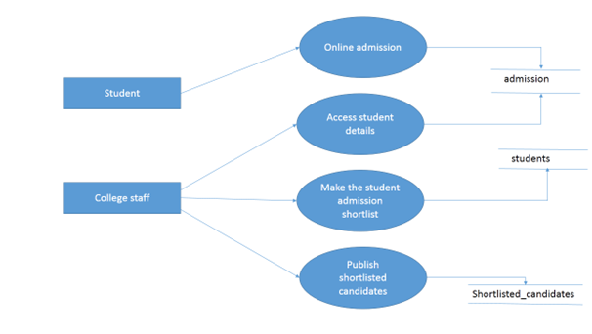
Methodology

Slide 9
IMPLEMENTATION
The Online College Admission System consists of three Modules such as User, Server and Admin.
A. USER
The student who wants to seek admission is the user of the online system. The student registers himself/herself with the system and becomes authenticated user after the login process. The students can seek admission in 2nd,3rd and 4th year of engineering college as per their academic year. The admission form is filled by the student after logging in the system and the documents such as previous years mark sheets, aadhar card, caste certificates, etc. are scanned and uploaded in the system. The application forms for provisional admission, photocopy and revaluation can be filled the user in the similar fashion. All these details can be accessed by the admin via server. If the admin verifies the form and grants permission to the user for admission, a message will be generated and sent to the student ID through server.If an unauthenticated user tries to login in the system, he/she is not permitted to do so

Slide 10
IMPLEMENTATION
B. SERVER
The Server acts as a medium between the authenticated user (student) and the admin. All the details entered and documents uploaded by the student is stored in the server (Wamp Server).The admin can access these details via server. When the admin verifies the student details and grants permission for regular admission/provisional admission/photocopy/revaluation process, a message will be generated to the user sent by admin via server.
C. ADMIN
The admin plays a pivotal role in the online admission system. It is the admin who provides authentication to the user in the online process. The details entered and the documents uploaded by the authenticated user is accessed by the admin via server.

Slide 11
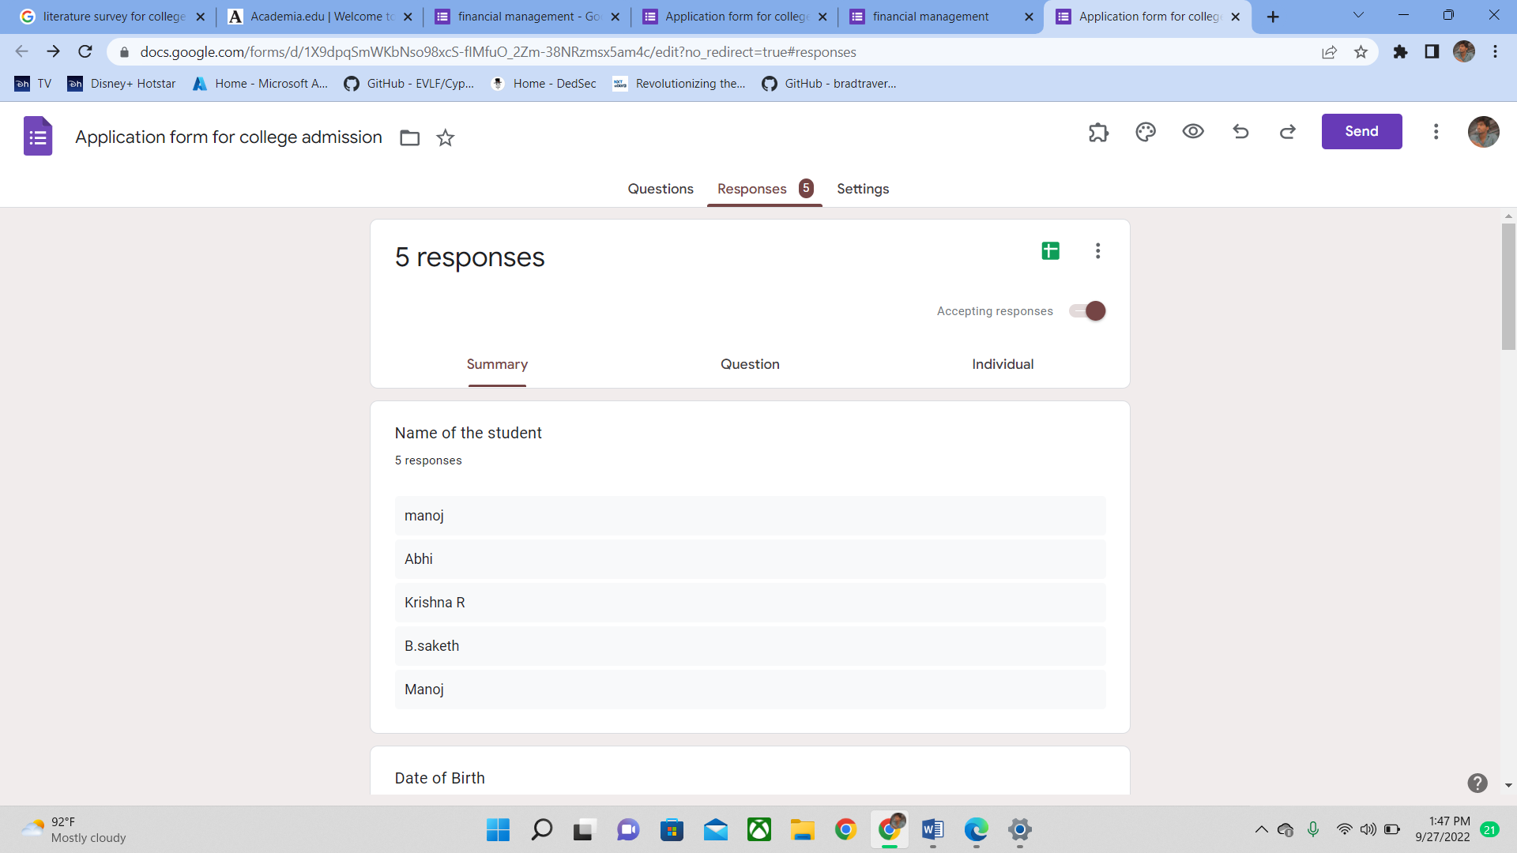
SURVEY

Slide 12
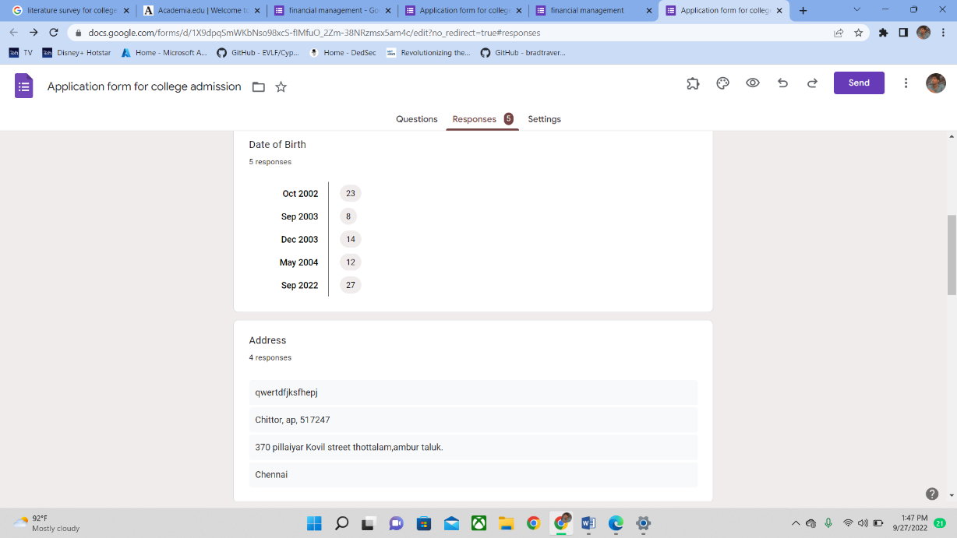
SURVEY

Slide 13
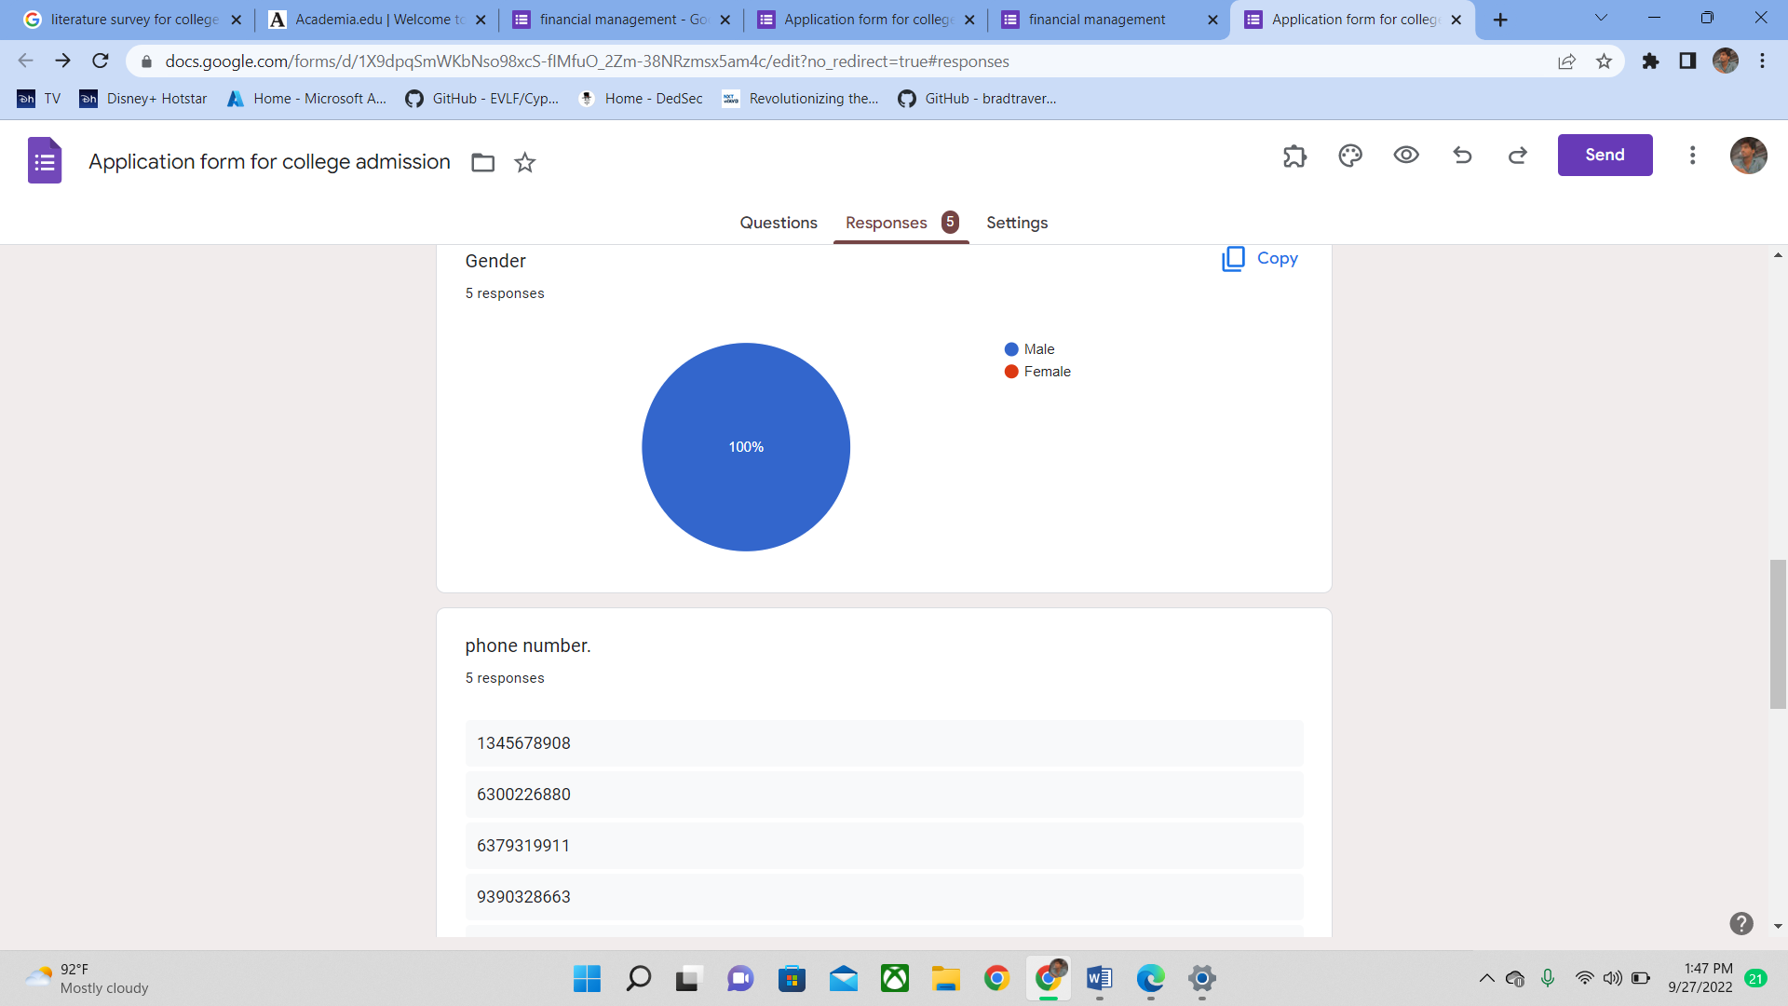
SURVEY

Slide 14
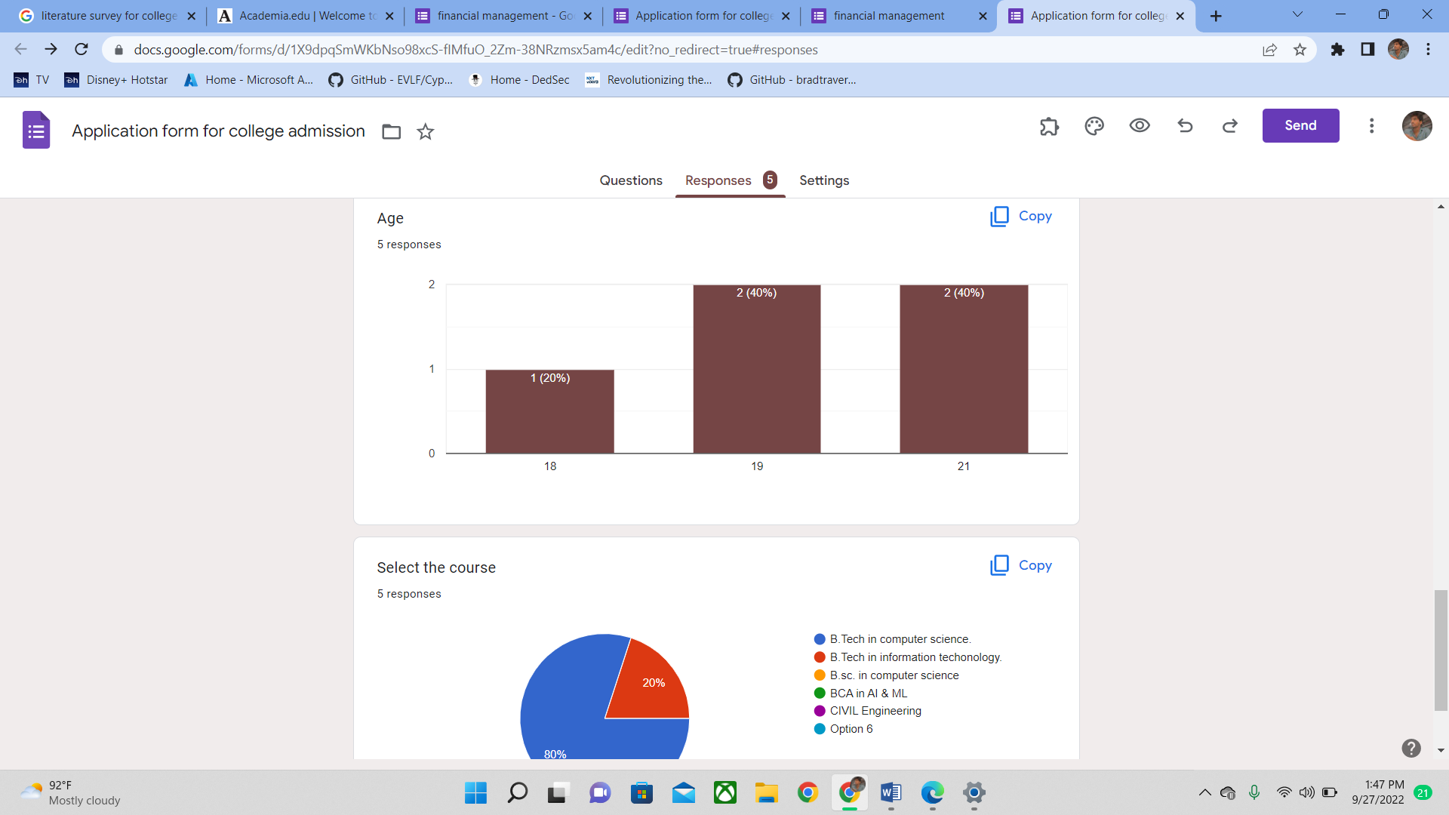
SURVEY

Slide 15
Advantages
The objective of online college admission system is to reduce the manual work and excess time taken for admission process. Student can login into the system by signing up. They can fill the form of admission
,revaluation, and photocopy. Also the details regarding the updated information of their admission is displayed on the window. The online college admission system ease the admission process by maintaining the database and retrieving the information of student easily. This system aims at being efficient and user-friendly.

Slide 16
Model Testing
During this phase a second set of data is loaded. This data set has never been seen by the model and therefore it’s true accuracy will be verified. After the model training is complete, and it is understood that the model shows the right result, it can be saved by: model.save(“name_of_file.h5”). Finally, the saved model can be used in the real world. The name of this phase is model evaluation. This means that the model can be used to evaluate new data.
.

Slide 17
CONCLUSIONS
In this way we are going to develop onlin college admission system , which minimize the time required for the manual admission process system. Records of the students can be produced easily in a short span of time. Workflow of the process will lead to efficiency and will be user friendly.

Slide 18
References
N. M. Z. Hashim and S. N. K. S. Mohamed, Development of Student Information System University Teknikal Malaysia Melaka, vol. 2, pp. 256 – 260, August 2013.
An Efficient Automatic Attendance System Using Fingerprint Reconstruction Technique. Josphineleela.R Research Scholar Department Of Computer Science And Engineering

